Slide 1

Analysis and prediction of the characteristics of Amazon Top 50 Bestselling Books 2009 - 2019
BAN620 Group 5
Abhishek Yadav
Devi Nadimpally
Priyanka Shah
Sayali Peshwe
Uttara Dabbiru
Victor Antony

Slide 2
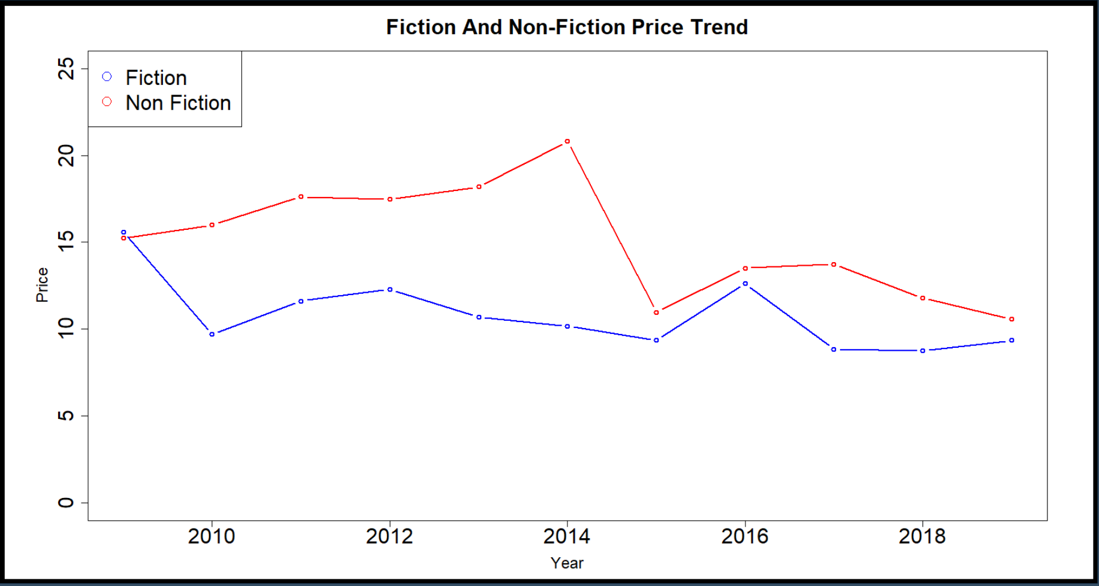

Problem Context and Objectives
Recently Amazon released it’s bestsellers list of books from 2009-2019
What factors contribute to making a book a bestseller and do we notice any trends ?
Can one/all of these factors be utilized in order to optimize or increase other factor(s)?
In other words, can we help the writers and publishers to increase their sales.
Main objectives
Analyze the factors the affect the book sales and predict the minimum number of bestseller books that would be bought by users
Analyze the factors that affect the price of the bestsellers books and predict the average price
Predict the more popular Genre for the future year based on factors like Author’s popularity, User Rating, Reviews, Price, Title
Price
Others
Genre
Author
Analyze & Predict Sales
Objectives
Analyze & Predict Price
Analyze and Predict Genre

Slide 3
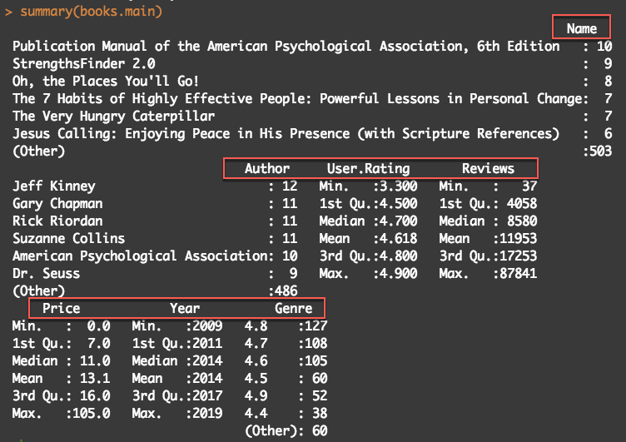
Description of dataset
Data set - Amazon Top 50 Bestselling Books 2009 - 2019 (Source - www.kaggle.com)
The data set contains a total of 550 books written by various authors from 2009-2019 along with price. There are Reviews and User Ratings given to the books.
Name of variable | Description | DataType
Name | Name/Title of the book | Categorical
Author | Author of the book | Categorical
User Rating | Amazon user Rating | Continuous
Reviews | Number of written reviews for book on amazon | Continuous
Price | Price of the book | Continuous
Year | The year when the book is ranked as bestseller | Categorical
Genre | Whether book is Fiction or Nonfiction | Categorical

Slide 4
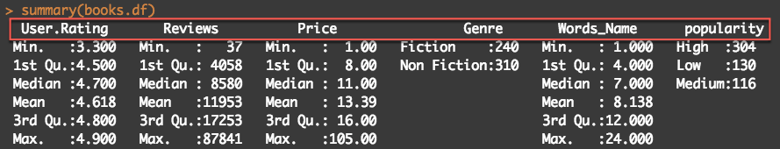
Initial Analysis
There were duplicate authors because of spacing issue. They were merged into one.
Author, gives life to a book. But how to derive meaning out of Author?
We believed the number of words chosen for the Name or Title of the book has an impact on the reader. As such we believed this may affect the number of books bought.
We considered Reviews as the count of the minimum number of books sold.
Summary
Data → Train Data(300 rows) , Validation Data(200 rows), Test Data(50 rows)
Conversion(based on # of times author appeared in best sellers list)
Popularity
- Low (1) - 130 books
- Medium(2) - 116 books
- High (3 or more) - 304 books
Author
(248 unique values)
Name/Title *categorical
Words_Name (number of words used for Name/Title of the book) *continuous

Slide 5
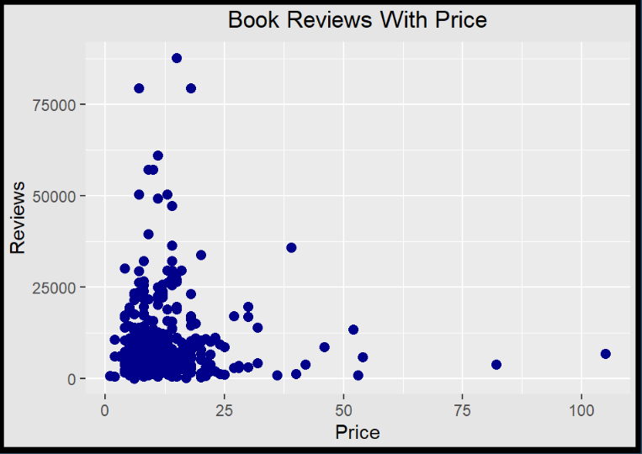
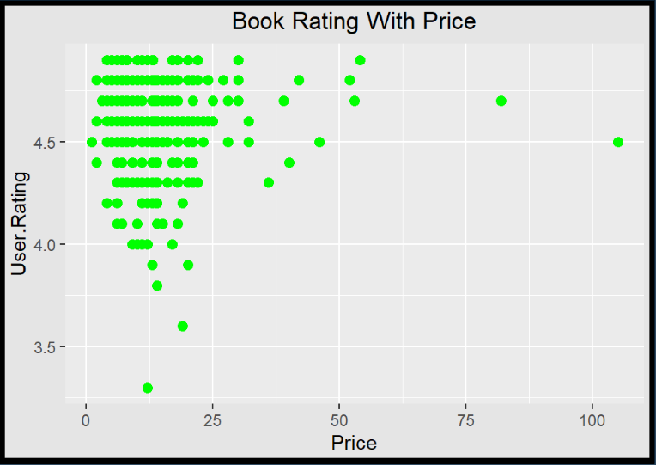
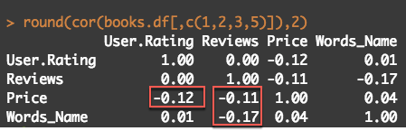
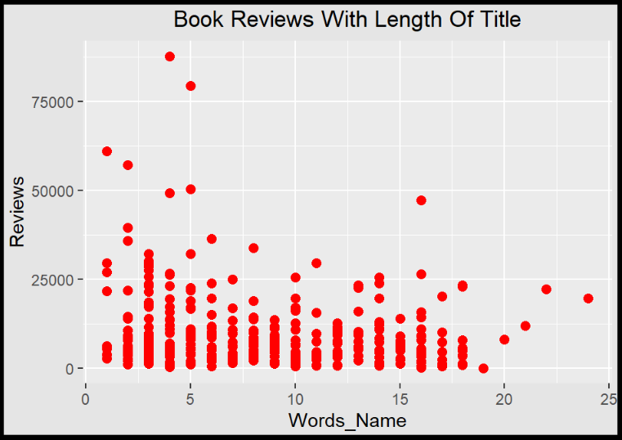
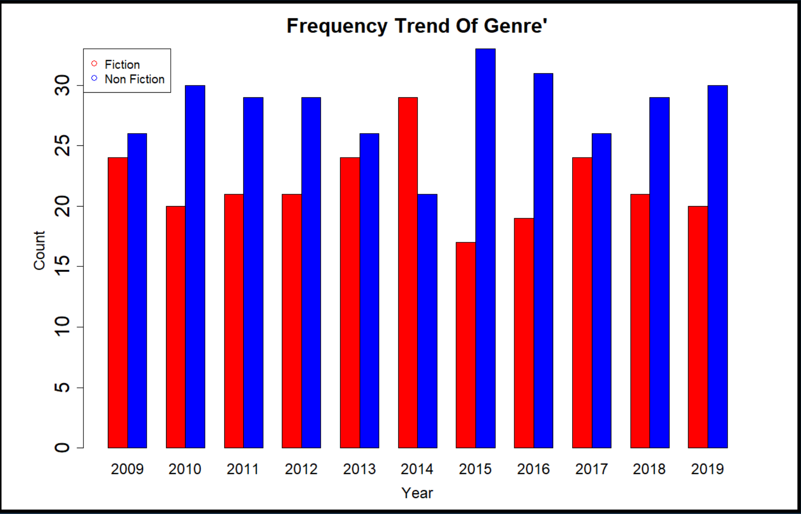
Initial Analysis
Books with most reviews are priced less than $25
Books priced more than $40 received fewer reviews
Books with title with less than 30 words received more reviews .
The number of reviews is decreasing significantly for bigger titles
Most of the books with a rating greater than 4.0 are priced within $25
Non-Fiction books are more popular than fiction books
Fiction books were more popular in the Year 2014
A negative correlation between Price and Rating shows a decrease in rating with a price increase.
A negative correlation between Price and Reviews indicates more reviews for cheap books.
Correlation between Word_name and Reviews shows low reviews for big title books.
Rating is independent of Reviews received on the book.

Slide 6
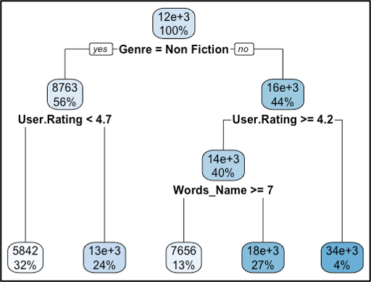
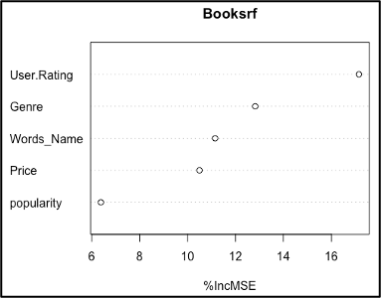
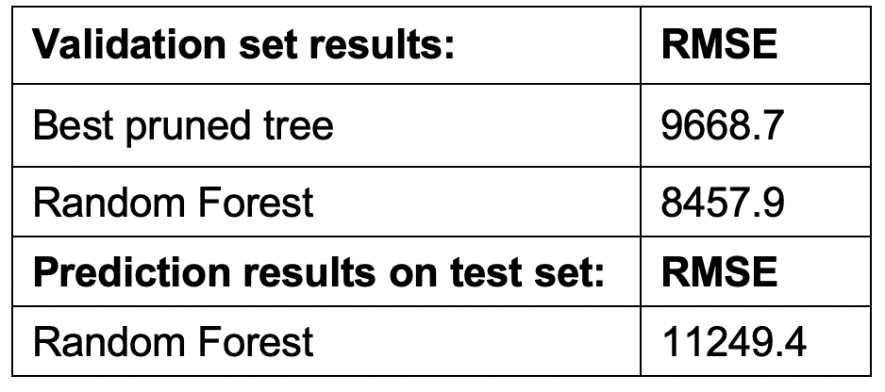
Analysis and Prediction for Sales
kNN Algorithm:
Using kNN we intend to predict the minimum number of reviews for Genre: Fiction and Nonfiction.
The best RMSE is achieved for k=3 .
RMSE calculated on validation data: 9850.18
Decision Tree Algorithm:
We achieved a better accuracy as compared to KNN for the best pruned tree.
Further, we employed techniques like Cross validation, random forest in view of achieving a better accuracy as compared to kNN.
It is interesting to find out that number of words in a title can possibly influence the number of reviews!
Average no. of Reviews predicted for test set: 13900
Notes:
The best RMSE is achieved for k=3. As we can see that the value of K is very low, it implies that the model will capture just the local structure and may have captured noise.

Slide 7
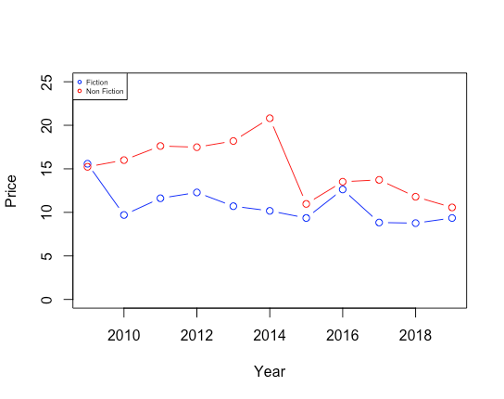
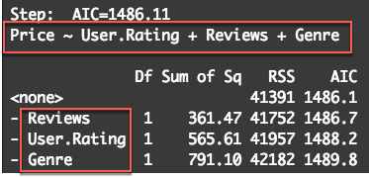
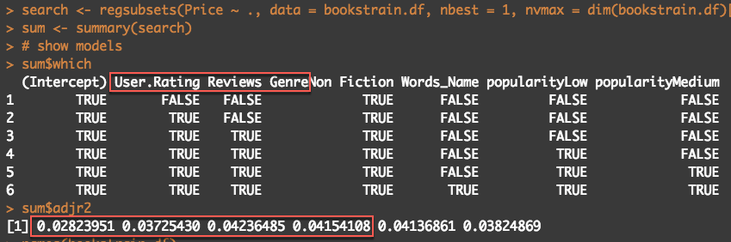
Analysis and Prediction for Price
Model - We used Multiple Linear Regression to analyze the factors that affect Price and to predict the average price of the best sellers book. -- lm(Price ~ ., data=bookstrain.df)
Observations
In order to find the best subset of variables Exhaustive Search and Backward Search was run.
Best variables suggested : User.Rating , Reviews & Genre
Accuracy was slightly less : RMSE: 8.65, MPE: -49.85
Final Model : (lm(Price ~ User.Rating, Genre, Reviews), data=bookstrain.df)
Prediction Results(on Test Data)
Accuracy : RMSE: 8.65, MPE: -62.82
Mean Predicted price : $14.06
Train Data | Validation Data
Significant variables(at 95% Confidence): User.Rating, Genre Residual standard error: 11.85 Adjusted R-squared: 0.04 | RMSE : 8.6 MPE: -49.8

Slide 8
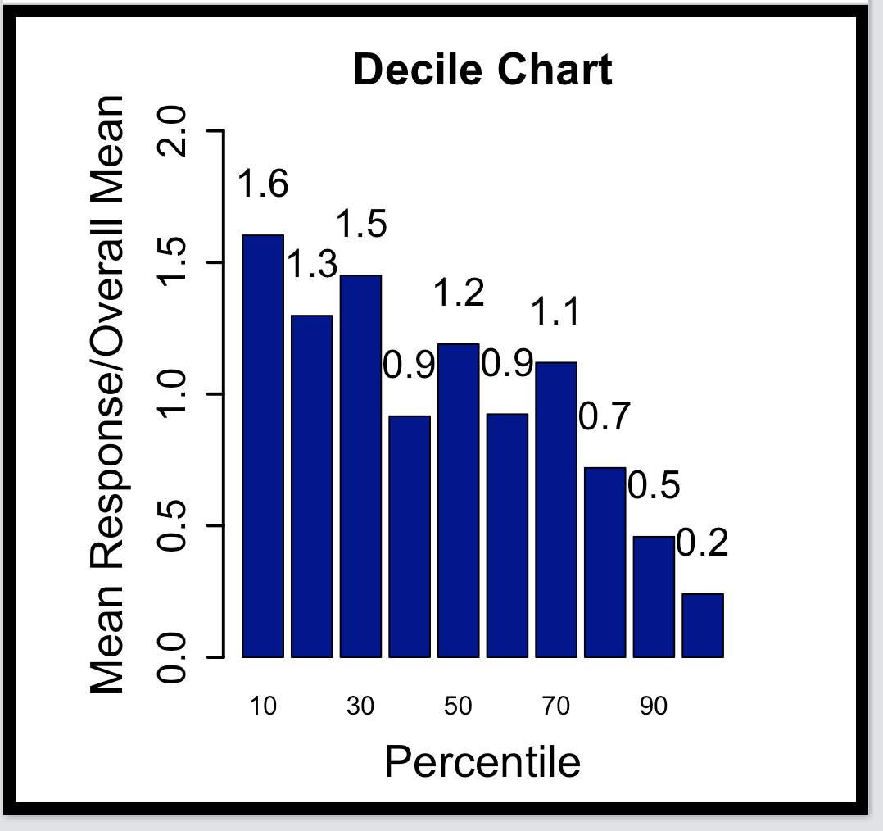
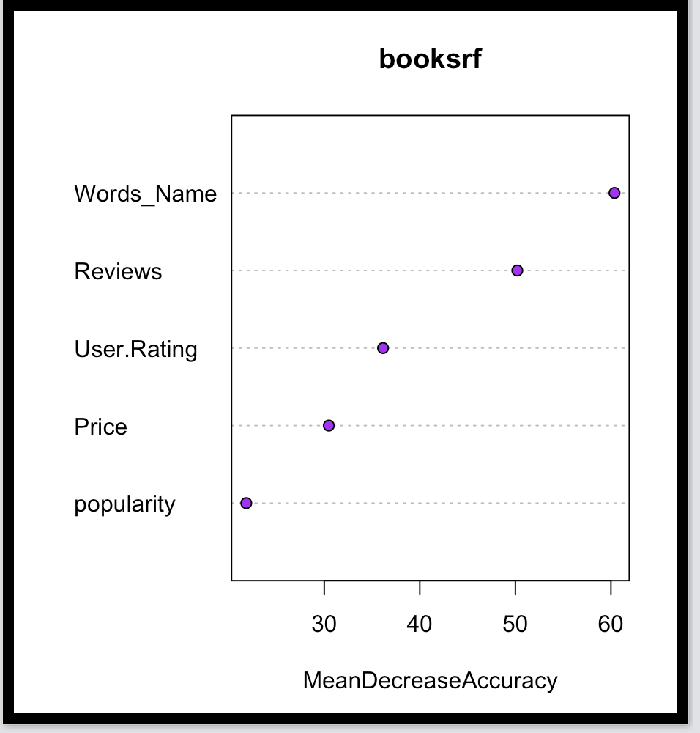
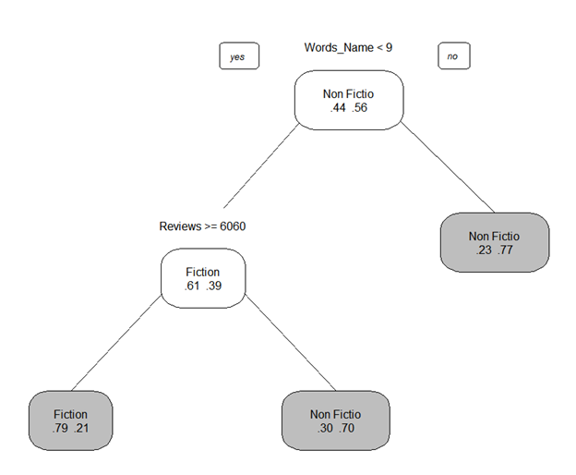
Analysis and Prediction for Genre
Model - We used Logistic Regression and CART algorithm to predict most popular Genre for the future (eg 2020).
Logit Algorithm:
Accuracy on validation data : 70%
Sensitivity(Fiction): 60% , Specificity(NonFiction): 77.6%
Decile chart - We do not see a consistent decline in the number of cases predicted.
CART Algorithm:
We got higher accuracy of 73.2% on default tree as compared to Logit.
With Random Forests we got higher accuracy of 81.6%.
Sensitivity(Fiction): 77.5% , Specificity(NonFiction): 84.6%
Prediction Results(on Test Data)
Accuracy: 88% , with wider confidence interval
Sensitivity(Fiction): 84.2%
Specificity(NonFiction): 90.3%
Predicted Genre : NonFiction

Slide 9
Comparison and Learnings
Reviews(Sales)
Price
Genre
kNN vs Decision Trees
Exhaustive Search(ES) vs Backward Search(BS)
Logit Vs Decision Trees
The best pruned tree and the Random forest showed an improved accuracy as compared to kNN.
Random Forest indicated User Ratings, Genre & Title word count are influential variables
Standard Linear regression model showed the significant variables are User.Rating & Genre
ES and BS showed the main variables are User.Rating, Genre and Reviews
In Logit, the Decile chart bars did not consistently decline
CART algorithm selected important variables on the top of the tree and gave a better model
Random Forest showed the main variables were Title word count and Reviews
The Random Forest in this dataset always gave the better accuracy for both Reviews and Genre.
When we increased the records in the test data the accuracy decreased for the test data than validation.
Our initial assumption about the Title word count may affect sales, turned out to be true.
We decided to use Reviews in the final model since we can predict reviews(Sales)

Slide 10
Conclusions and Recommendations
01
Choose Name/Title with less than 10-12 words to sell more books.
Amazon User Ratings, Genre and the Number of words used for the title of the book affect the number of books sold
02
New Authors should try to produce NonFiction books as they are priced higher.
Since we can predict Reviews(sales), we can make use of this to determine the best price
Genre and User Rating are the main predictors for Price
Reviews slightly affect the Price of a book
03
A Name/Title of 5-13 words are usually used for NonFiction books
The more popular Genre for the future year is NonFiction
Title of the book affects Genre

